Slide 1

A Dissimilarity Based Concordancer
Submitted By:
Shonna Gu
Nicholas Sanders
Komal Mistry

Slide 2
About the Team
Komal Mistry | Shonna Gu | Nicholas Sanders | Prof. Miikka Silfverberg
B.Tech in electronics and telecommunications engg from MPSTME Mumbai. MBA in Business Intelligence and Analytics from NMIMS, Mumbai | Bachelor in Internet of Things Engineering at Beijing Institute of Technology Master in Computer Science at Beijing Institute of Technology | BA in Linguistics from Western Washington University | PhD in Language Technology from the University of Helsinki in 2016. Postdoctoral researcher at the University of Colorado at Boulder where he worked on computational modeling of word structure using deep neural networks.
We’d also like to thank our CRIM mentors Pierre André Ménard and Lise Rebout for their constant guidance and support.

Slide 3
What is a Concordancer ?
A concordancer is a tool to show a target word in its context.
A concordancer (sometimes called key word in context or KWIC) is a useful tool for linguists, computational linguists or data scientists who need to target specific query word in a text corpus to explore the cues, hints and context that underlie the use of such a phenomenon
It aligns instances of the query word found in a corpus and shows the surrounding words, enabling the user to assess the context of the term in the corpus.
Concordancers have traditionally been used to provide easy access to key ideas in religious scripts like the Bible, Vedas and Quran to name a few.
With advances in technology, concordancers are now used in corpus exploration, providing linguists with a tool to study a large corpus by comparing different uses of a term, finding phrases, and examining idioms used in the text.

Slide 4
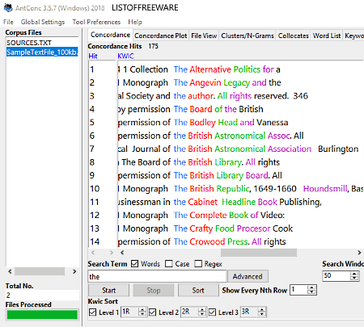
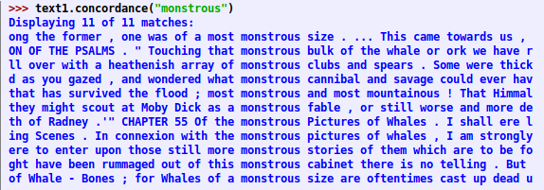
Current Concordancers

Slide 5
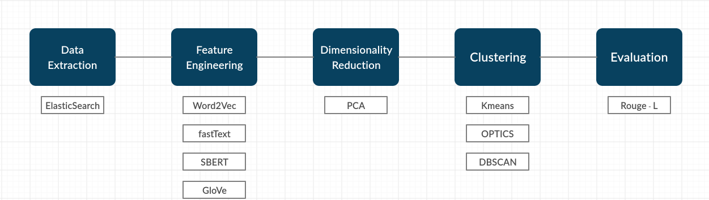
Project Flow

Slide 6
Applications of Concordancers
Concordancers have applications in English Language Teaching (ELT) , where they are used to acquaint learners with collocations and word usage.
Using concordances, students can learn the frequency of use and the context in which words should be used (Fatih 2014)
Furthermore, within the field of computational linguistics, concordancers can be used to explore corpuses and enable researchers to quickly analyse a large corpus for frequency of n-grams and corpus diversity
Many large corpora, like the American National Corpus, British National Corpus, or Corpus of Contemporary American English, are released with concordancing features enabled.

Slide 7
Why a dissimilarity based concordancer
Typical and historical concordancers are similarity-based and return all matching occurrences, or concordances, for a given target word.
This allows for a user to observe how a word appears in a corpus, but can be exhaustive, as often all concordances must be manually parsed by the user to be of any use.
We investigate and propose an automatic alternative method for returning the most different concordances, based on dissimilarity.
We do this by exploring different feature engineering methods for text data, unsupervised clustering algorithms, and dimensionality reduction techniques.

Slide 8
Phase 1 Datasets
datasets | name | language | document count | token count | Annotated or not
Travaux de l’assemblée nationale | Assnat | French | 5,484 | 231M | yes
COVID-19 Open Research Dataset | Covid | English | 57,368 | 295M | yes
Note: the datasets are quite big that each one takes ~80G space after decompression.
Notes:
We have two datasets, which are assnat and covid. Assnat is a French corpus that collects documents of the parliamentary work in Quebec. It contains ~five thousand documents and over 200 million tokens. Another English corpus, Covid, is built upon more than 57,000 scholarly articles related to the novel coronavirus. It’s worthy mentioning here that the datasets are quite big, like the assnat dataset takes ~80G space after decompression.

Slide 9
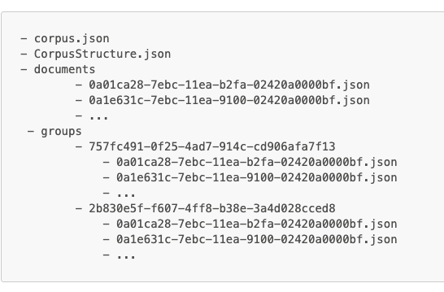
Phase 1 Datasets
corpus.json
basic information of this corpus
e.g. corpus id, corpus title, language, document counts
CorpusStructure.json
detailed structure of ‘groups’
documents
file names are document ids
each document includes an id, source, title of the document, full text and the language
groups
annotation files
one group is about document metadata
another is about split sentences and tokens
Notes:
Then let’s take a look at dataset structure. Both of two datasets follow the same structure. Basically, each one has two json files and two folders. Corpus.json contains basic information of this corpus, like corpus id, title, languages and document counts. CorpusStructure.json file explain the detailed structure of groups folder. The documents folders maintain a set of raw documents. The group folder has another two sub-folders. One is about document metadata and another is actually annotation files that cover split sentences and tokenized words.

Slide 10
Phase 1 Data Retrieval using ElasticSearch
What kind of data we need
query word and its contexts
e.g. oral administration only elicited an IMMUNE response in one of six
What difficulties we have when retrieving data
no enough space for decompression
a linear search function takes an incredibly long time to execute
How we solved the problems
read data from zip file(~7G) directly
built Elasticsearch indices for quickly searching targets
How we used Elasticsearch in this project
created indices upon each document and retrieved all documents that contain a query word
extract instances by iterating these retrieved documents
Note: Elasticsearch is an open source distributed, RESTful search and analytics engine capable of efficiently solving search and querying for large datasets
Notes:
Returning back to our task, what kind of input data we expect? Given a query word, we need to capture all occurrence of this query word and its left and right context. The first challenging we meet during this stage was that there’s no enough space for decompressed datasets. And another one is a linear search function takes a long time to execute. Therefore, we try to read data from original zipfile instead of unzipping it. And in order to retrieve matches from massive documents in real time, we built Elasticsearch indices for each document. Elasticsearch is an open source distributed, RESTful search and analytics engine capable of efficiently solving search and querying for large datasets. So depending on that, we retrieved all documents which contain a query word and then filter out all instances by iterating these documents.

Slide 11
Phase 2 Feature Engineering
This phase of the pipeline consists of deriving meaningful features from the contexts / instances retrieved from the elasticsearch querying
The goal is to vectorize this collection of instances so that we can use clustering to return a diverse set of concordances, based on the features represented in the vectors.
In our implementation we consider each context to be an aggregated vector which is formed from the vectors of the words found in the context. To explore the efficiency of word embeddings, we chose four techniques to extract vectors:
a. Word2Vec (model derived from 10,000 documents in COVID and 1000 documents in Assnat corpus)
b. GloVe (Use pre-trained embeddings to overcome the issue of local statistics faced in the Word2Vec model)
c. fastText (Use pre-trained embeddings to overcome OOV problem by utilizing character level embeddings)
d. SBERT (Use pre-trained embeddings , current state of the art technique for extracting semantically meaningful vectors)

Slide 12
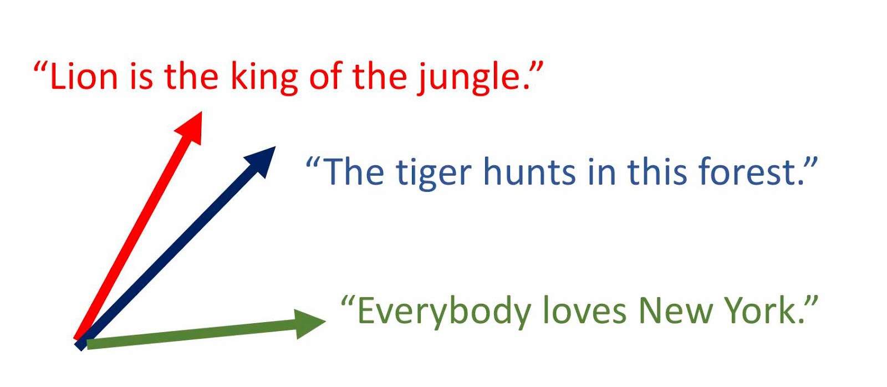
What is a Word Vector

Slide 13
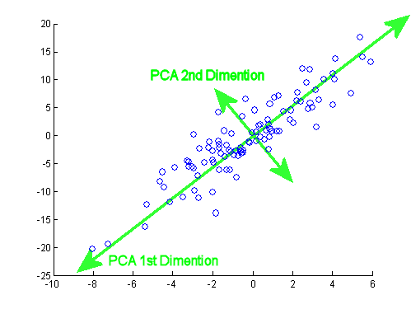
Phase 3 Dimensionality Reduction
Principal Component Analysis (PCA)
https://medium.com/@raghavan99o/principal-component-analysis-pca-explained-and-implemented-eeab7cb73b72
It finds the directions of maximum variance in the higher dimension and projects this variance into a lower dimension , thus preserving most of the observed variance from the original word embeddings, while reducing the number of dimensions of the word embeddings
Notes:
Uses correlations to find patterns in the data.

Slide 14
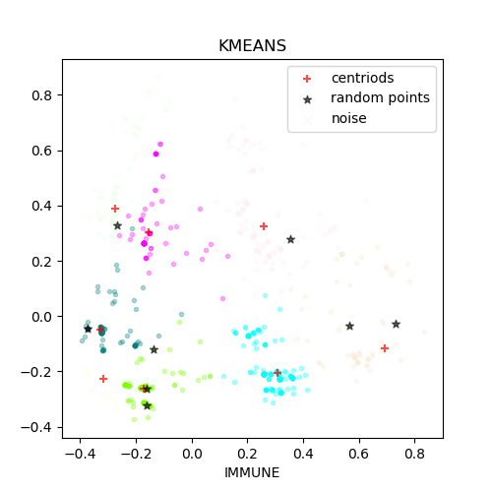
Phase 4 Clustering
What is clustering in unsupervised learning
An algorithm that can group or cluster data points based on position in space using a given distance metric (we use cosine similarity)
Why do we choose clustering
Clustering is used so that we can classify data points and maximize diversity of concordances by returning each cluster’s most center point (the centroid)
Different clustering methods examined
We examined KMeans, DBSCAN, and OPTICS from scikit-learn, which all come with different performance implications (will be explained further)

Slide 15
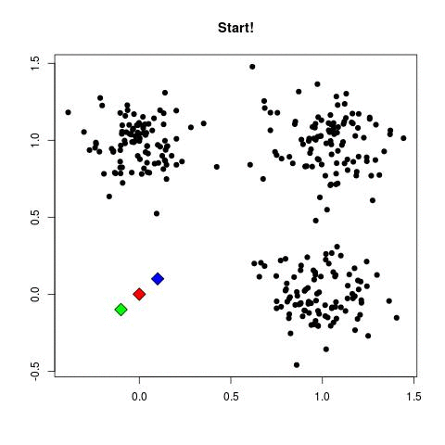
Phase 4 Clustering - KMeans
How does KMeans work
Randomly initiate centroids and assign data points to their closest centroid, recalculate the cluster centroids based on the mean of all data points within each cluster and repeat
https://i.imgur.com/k4XcapI.gif

Slide 16
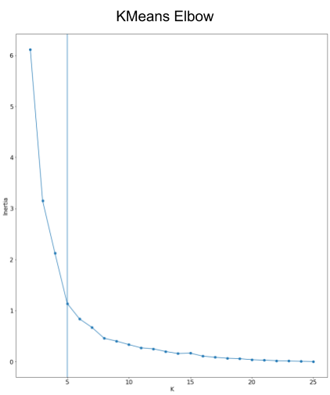
Phase 4 Clustering - KMeans
How are we choosing the hyperparameters
‘K’ clusters determined by automatically finding the elbow in a distribution of inertias (the avg. distance of data points from centroids)
Iterations set to 300 (default)
Considerations:
Some randomness and sensitive to noise

Slide 17
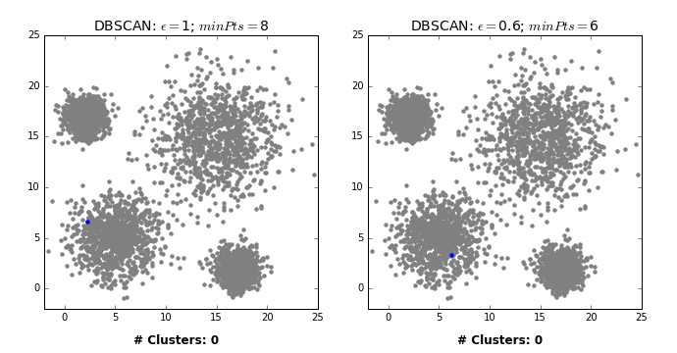
Phase 4 Clustering - DBSCAN
How does DBSCAN work
Density Based Spatial Clustering of Applications with Noise. Using its hyperparameters and given metric to determine clustering.
https://dashee87.github.io/images/DBSCAN_search.gif

Slide 18
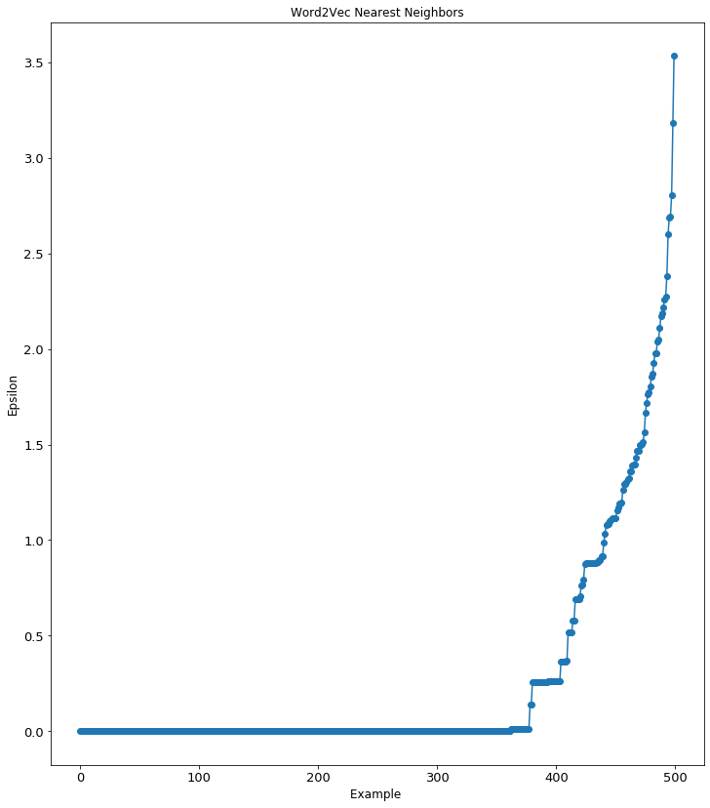
Phase 4 Clustering - DBSCAN
How are we choosing hyperparameters
Determining epsilon (measured in euclidean distance) and minimum samples with distance of nearest neighbors and trial and error
Considerations:
Epsilon and minimum samples are hard to determine and sensitive to other system parameters

Slide 19
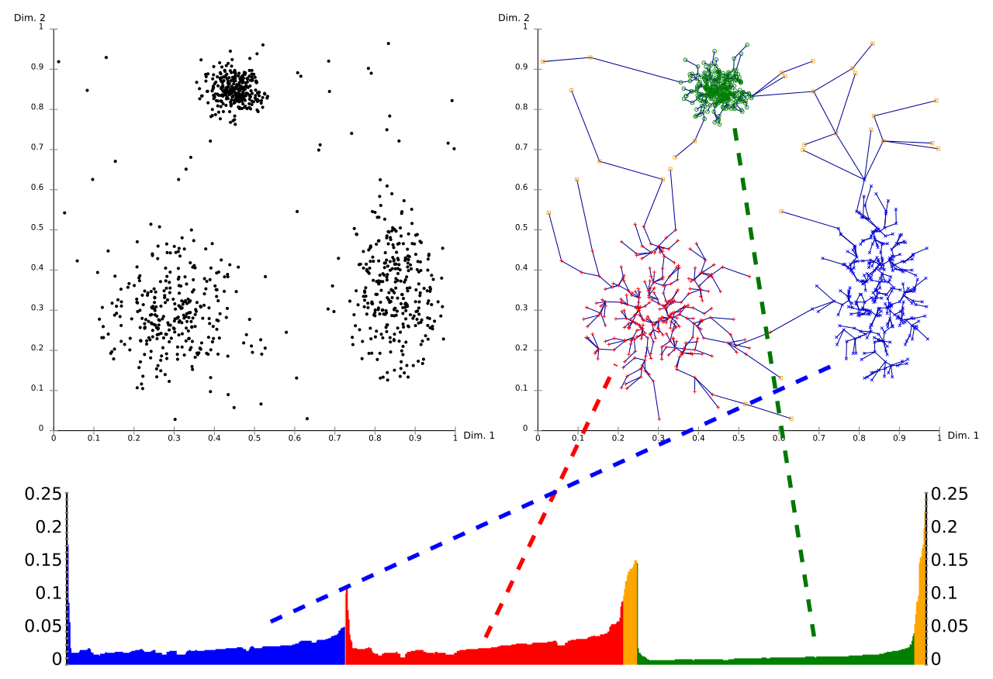
Phase 4 Clustering - OPTICS
How does OPTICS work
Ordering Points to Identify Cluster Structure. Value is set for min samples, calculates a core distance and reachability distance for each data point, and then updating cluster centroids
How are we choosing hyperparameters
Minimum samples chosen through trial and error based on other parameters
Considerations:
Less hyperparameters can mean less control
By Chire - Own work, Public Domain, https://commons.wikimedia.org/w/index.php?curid=10293701

Slide 20
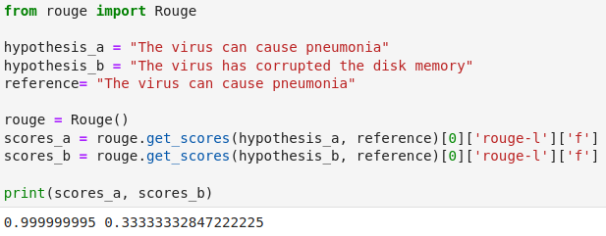
Evaluation
After clustering the word embeddings , we extract the cluster centers or take random samples from each cluster as per clustering technique. This new set of samples is then treated as our final context diverse concordance result for a given query word.
We use a metric called ROUGE ( Recall Oriented Understudy for Gisting Evaluation ) to evaluate the context diversity of the resulting concordances.
Rouge metric is calculated by counting the ngram overlaps occurred between two text samples.
Notes:
Therefore if we were to calculate a ROUGE score of two identical text samples it would be one and the more dissimilar the text samples, the lower the ROUGE score will be.

Slide 21
Evaluation
We would expect the ROUGE score before clustering to be higher than the ROUGE score produced after clustering and in general for any given concordance output we would like to observe lower ROUGE scores to indicate that the samples are context diverse.
We use the ROUGE - LCS variant, LCS standing for longest common substring. The reasoning behind it being that if two text samples were to have the same phrase or LCS then it’s most likely that they have used the query word in the same context.

Slide 22
Results
Query words | Number of clusters | Cluster results | Rouge score-KMeans | Random results | Rouge score-Random
PAUCITY | 16 | normal . The PAUCITY of lung findings was . There is a PAUCITY of bat-borne virus break the of PAUCITY severe of acute new reflect risk PAUCITY of this studies end sidering the PAUCITY of information avai ion The type PAUCITY . Cross-provincial dge gaps and PAUCITY of scientific data o . A relative PAUCITY of resident alveolar oglia . This PAUCITY of Ia Ag on astro lly the by , PAUCITY of data to level v , an overall PAUCITY of basic residues rently mice PAUCITY studies lack microb 44 subjects PAUCITY in CD4+ studies ( ) s where data PAUCITY is present and impli 7 ] There is PAUCITY of population-based mediated on PAUCITY the of virus emb | 0.2375 | their relative PAUCITY emphasizes the clinical use , PAUCITY of evidence-bas rveillance and PAUCITY of disease burd Further , the PAUCITY of asthma hospi t . There is a PAUCITY of data surroun ons there is a PAUCITY of data about t . . 2014 to US PAUCITY estimated data ed , given the PAUCITY of laboratory-b y , there is a PAUCITY of comparative le where snail PAUCITY present and imp ly reflect the PAUCITY of clinical stu 20 ] there is PAUCITY of data on the systems , the PAUCITY of animal-infec o to influenza PAUCITY ( reliable et c B1 vaccine is PAUCITY chemically LBP ozoa , and the PAUCITY of ciliates , r | 0.2875
Note: KMeans + Sbert + PCA dim = 16 + window size = 1
Notes:
Given the model we proposed, we ran several tests on different query words. Here is an example of word, ‘Paucity’. After clustering, we had 16 clusters which means we would have 16 concordance results. The rouge score for this was ~0.24. And remember that lower the rouge is, less similar the instances are and finally better results we get. So the rouge score for randomly picked instances was ~0.29 which was higher than KMeans results. It proves that in this case, Kmeans could beat the randomness. If you take a close look at the random results, especially the blue instances, you will find that ‘there is a paucity of data’ is a kinda redundant.

Slide 23
Results
Query words | Number of clusters | Cluster results | Rouge score-KMeans | Random results | Rouge score-Random
INFECTION | 25 | earch on viral INFECTION indicated that a on , including INFECTION of humans . HPAI ion acute hMPV INFECTION . During the tim s of childhood INFECTION appear to be mil ve evidence of INFECTION . Immunofluoresc RS coronavirus INFECTION ( Lee et al. 200 ource of human INFECTION with Middle East read safety it INFECTION be activities wi supported MHV INFECTION of transfected 2 and rotavirus INFECTION ; IgG ASCs were ous studies as INFECTION and disease mode information on INFECTION control , we als and abdominal INFECTION will cause pain luenza A virus INFECTION in cats in China are-associated INFECTION and the incidenc ) . During an INFECTION , the host prote owing neonatal INFECTION . This , in turn C3 without DV2 INFECTION ( Fig. 1A-b ) . The day before INFECTION , RAW264.7 cells | 0.0267 | related to MERS INFECTION as it is kno suggested PEDV INFECTION could be mor e prevalence of INFECTION varies betw were the after INFECTION microinjecti persistence of INFECTION is ability o pected be virus INFECTION Before Howev s simplex virus INFECTION of Vero cell diated p.i. was INFECTION in with comp ute respiratory INFECTION (SARI)a resp , at least mild INFECTION , in childre g sublethal IAV INFECTION results in i nt of influenza INFECTION . Because of othesis , viral INFECTION frequently h regulated upon INFECTION with IAV , a y to mycoplasma INFECTION in cattle ha haviors against INFECTION , there shou l and bacterial INFECTION through rapi tests confirmed INFECTION with SARS-CO lting from MERS INFECTION , as well as | 0.0322
Notes:
Here is another test, on word, ‘Infection’. For this word, we got 25 clusters and Kmeans score was a little bit lower than the random score. If looking at the random results, there’re several instances sharing some common information

Slide 24
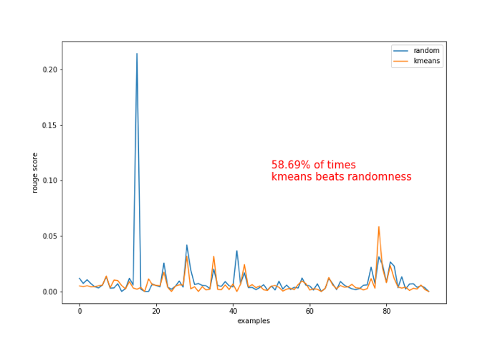
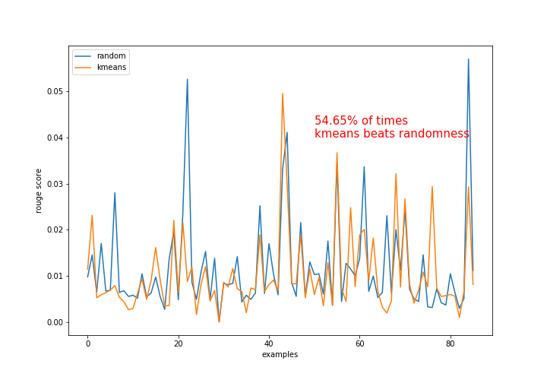
Test on 100 query words
Covid
Assnat
Notes:
Apart from single word tests, we investigated 100 words from covid corpus and 100 words from assnat corpus respectively. In terms of Covid corpus, more than 58% of times our clustering method could beat randomness; And for Assnat, it was 54%. That means, generally speaking, clustering results could achieve a better performance than randomness.

Slide 25
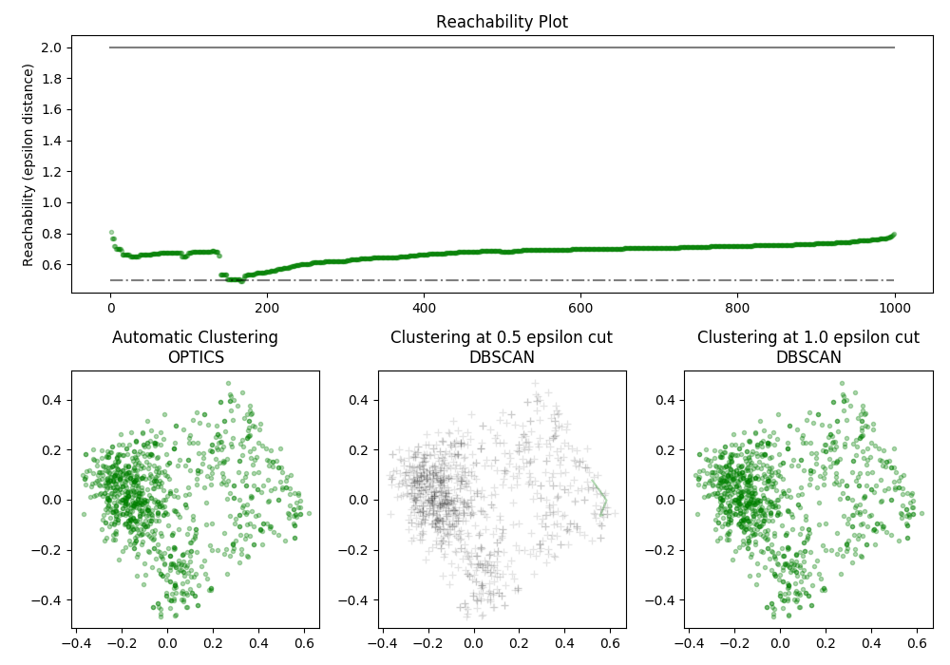
Comparison between clustering techniques
Reachability
distance from a data point to a core point
OPTICS
all points in one cluster
within 1.0 epsilon distance, all points are reachable
DBSCAN at 0.5 eps
gray points are regarded as noise
no cluster
DBSCAN at 1.0 eps
all points in one cluster
same result as OPTICS
Note: OPTICS’s Xi method can account for different choices of eps in DBSCAN
Notes:
This figure is comparing two clustering methods, optics and dbscan. Looking at the top plot, reachability plot. The reachability means a distance from a data point to a core point in this cluster. Each green point represents a real data point and all points are in green means they are in one cluster. This plot says all points could be connected to a core point within 1.0 distance. It exactly corresponded to the clustering results from OPTICS, looking at the first sub-plot below. And then switching to the second plot, it shows DBSCAN results at 0.5 epsilon. All points colored in gray mean they are all regarded as noise. So there’s no cluster. How about DBSCAN at 1.0 epsilon. We could see that it’s same as OPTICS that all points in one cluster. In summary, OPTICS and DBSCAN are not stable in this case because they tend to be sensitive to some parameters like min_samples in OPTICS and epsilon in DBSCAN.

Slide 26
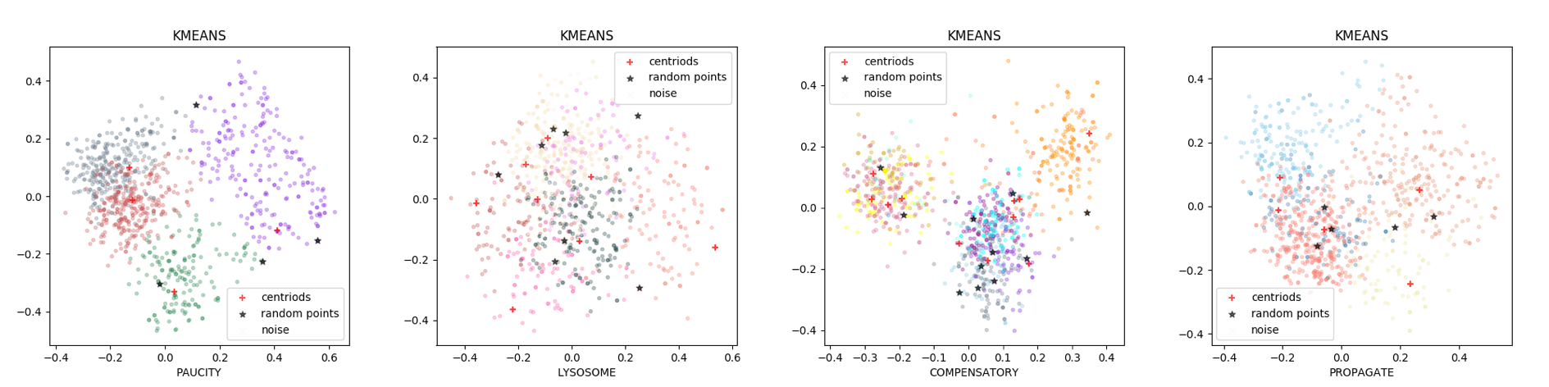
Comparison between clustering techniques
Results | Rouge score
basis , there is a PAUCITY of data on the long-term visits Initially the by , PAUCITY of data to level values a s , paralleling the PAUCITY of melanomas reported in other report in 2 , the PAUCITY has of to experimental all | 0.0185
blood vessel walls which induce LYSOSOME enzyme liberation from neutrophils hydrolyzed by proteases in the LYSOSOME , antigen fragments generated by autophagosome subsequently fuses with a LYSOSOME , enabling the intra-autophagosomal components directly taken up by the LYSOSOME , either through invagination of . to Biol the 17(4) LYSOSOME e2007044 . begins with packaging of the substrates into the LYSOSOME [ 107 ] . The it phagosome directly capture data LYSOSOME , a in that instruments the mode of administration of LYSOSOME targeted medica tions in order | 0.0039
Notes:
Contrast with OPTICS and DBSCAN, KMeans takes consideration of all data points. The only one parameter needs to be controlled is the number of clusters K. We built a function calculating the optimal K. Here are two examples, results on words, ‘paucity’ and ‘lysosome’. You may see that the data points are classified into several quite distinctive clusters. Then we pick up centroids of each cluster as a results which are listed on the table.

Slide 27
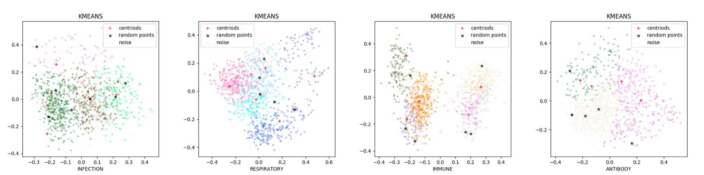
Comparison between clustering techniques
Results | Rouge score
oral administration only elicited an IMMUNE response in one of six signaling crosstalk that programs the IMMUNE response to virus infection . of autoantigenic material to the IMMUNE system but , again , For example , when endogenous IMMUNE cells lose their ability to of also IBV induce sequences IMMUNE all Asian countries excluding China | 0.0667
of cattle induce a strong ANTIBODY response , the time delay in our view . Once ANTIBODY coating proceeds beyond a critical risk passive of transfer = ANTIBODY vaccinated a at protective vaccinee unvaccinated with 1:3000 dilution of anti-His-tag ANTIBODY ( Invitrogen ) in PBS-T antibody cDNA . The obtained ANTIBODY cDNA is inserted into expression | 0.0
Note: KMeans + Sbert + PCA dim=2 + Window size = 5
Notes:
‘paucity’ and ‘lysosome’ are two low frequency words in our dataset. And now we test two high frequency words, IMMUNE and ANTIBODY. As we can see from the pictures and table, there’s no big difference when clustering high/low frequency words.

Slide 28
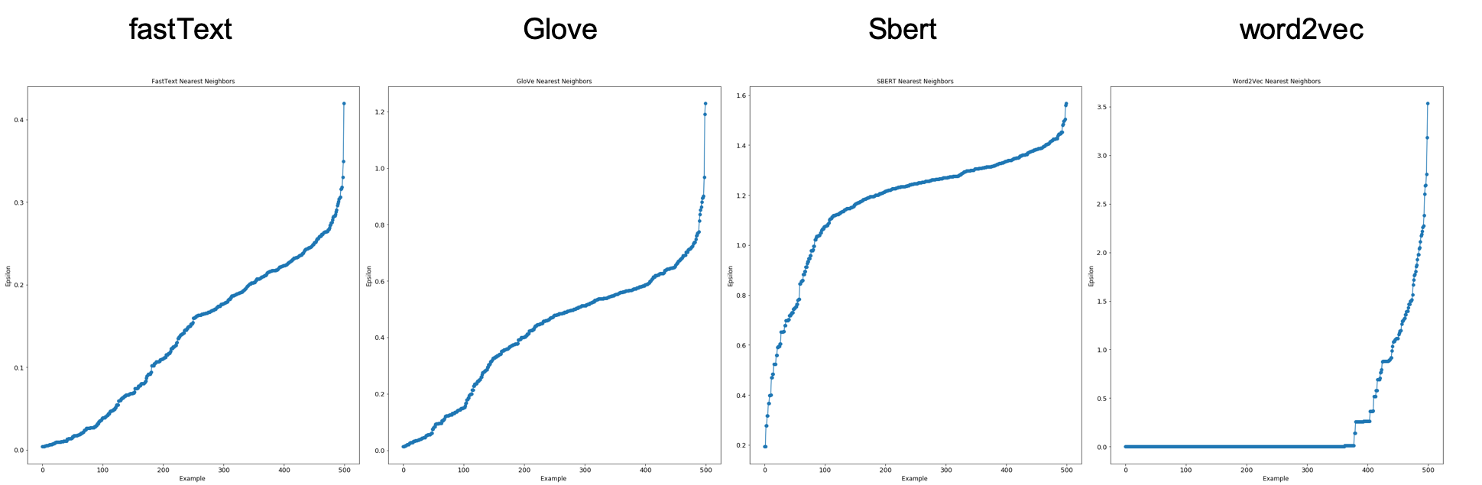
Nearest Neighbors’ Distance Distributions

Slide 29
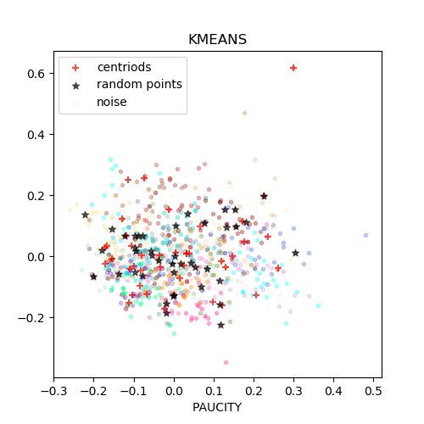
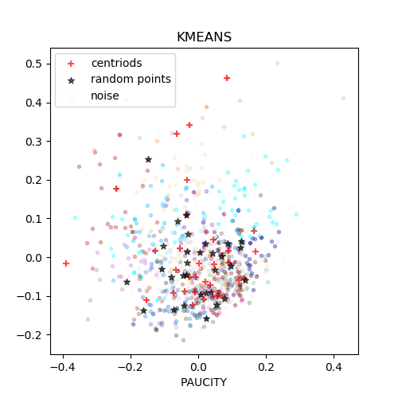
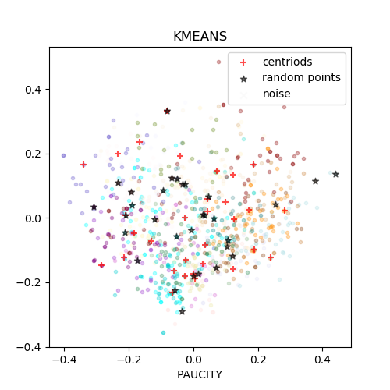
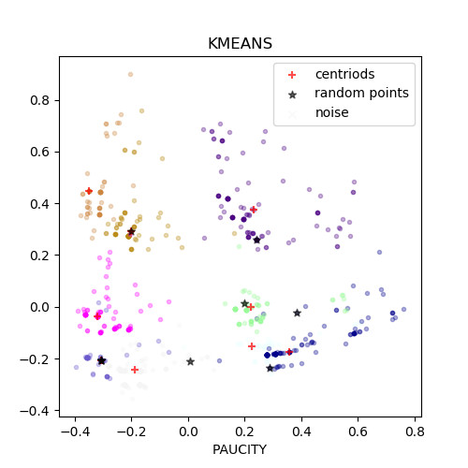
Clustering on Different Features
fastText
Glove
Sbert
word2vec

Slide 30
Fundamental Differences in Features
Differences in Embedding Methodology:
How the context feature embeddings (fastText, Glove, sbert, and word2vec) are derived for each method are different.
Differences in Training/Pre-training and Ramifications:
Word2vec was trained on the corpus while other models were not.
Issues with Using Rouge to Compare Methods:
Rouge score alone may not really capture the difference in these methods as it is a token similarity based metric.

Slide 31
Challenges and Future Work
Since ROUGE is an n-gram overlap based approach, it doesn’t take into account the semantic or syntactic level of information contained. There are some other ROUGE variants worth exploring like ROUGE - synonyms and ROUGE - AR.
Weighting words based on index in the sequence could change the effect of window size on clustering
Creating our own models for both token-based and context-based vectorization from scratch to be better suited for our corpora domains and task
Defining desired linguistic differentiation between concordances

